Slide 1
AIA’s Antitrust Statement
It is the practice of The American Institute of Architects (“the Institute” or “the AIA”) and its members to comply strictly with all laws, including federal and state antitrust laws that apply to AIA operations and activities. Compliance with the letter and spirit of the antitrust laws is an important goal of the AIA, and is essential to maintaining the Institute’s reputation for the highest standards of ethical conduct Statement in Compliance With Antitrust Law The following practices are not, in themselves, unethical, unprofessional, or contrary to any policy of The American Institute of Architects or any of its components:
submitting, at any time, competitive bids or price quotations, including in circumstances where price is the sole or principal consideration in the selection of an architect
providing discounts; or
providing free services. Individual architects or architecture firms, acting alone and not on behalf of the Institute or any of its components, are free to decide for themselves whether or not to engage in any of these practices. Antitrust law permits the Institute, its components, or Members to advocate legislative or other government policies or actions relating to these practices. Finally, architects should continue to consult with state laws or regulations governing the practice of architecture.
AIA Tennessee >> 2023 Annual Business Meeting

Slide 2
2023 Annual Business Meeting
Wednesday, October 25, 2023

Slide 3
Treasurer's Report
AIA Tennessee >> 2023 Annual Business Meeting

Slide 4
Election of Officers
AIA Tennessee >> 2023 Annual Business Meeting

Slide 5
2024 Slate of Officers
Nomination: Vice President | Charles “Chad” Polk, AIA | Nashville
Nomination:
Treasurer | P. Jeanne Myers, AIA | Two-year term ending 12/31/25
Secretary | Julius Mitchell, AIA | Nashville (Filling Sec. Vacancy - term ending 12/31/2024)
Officers for 2024 not open for Election:
President | Matt Lyle, AIA | Chattanooga
President-Elect | John Thurman, AIA | Knoxville
Immediate Past – President | Valentina Puppione Cochran, AIA | Nashville
AIA Tennessee >> 2023 Annual Business Meeting >> Election of Officers

Slide 6
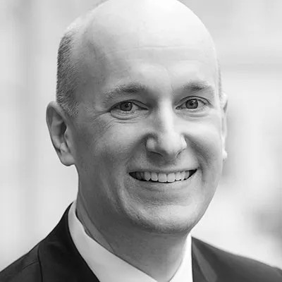
Josh Flowers, FAIA
TN State Strategic Councilor
AIA Tennessee >> 2023 Annual Business Meeting

Slide 7
2023 Strategic Council Update
AIA Tennessee Business Meeting
October 25, 2023

Slide 8
AIA Strategic Council Purpose
STRATEGIC COUNCIL
The Strategic Council’s purpose is to develop ideas to inform future needs and opportunities for the profession.
The Strategic Council develops topics and presents our ideas to the AIA Board of Directors for consideration and alignment.

Slide 9
AIA Strategic Council Representation
STRATEGIC COUNCIL
The Strategic Council includes 70 representatives from
All 50 states
US territories and District of Columbia
International components
Past, present, and future AIA leadership
At-large representatives
AIAS Leadership
Associate AIA leadership
CACE leadership.

Slide 10
2023 Strategic Council Study Groups
STRATEGIC COUNCIL FOCUS TOPICS
Carbon
Design
Equity
Economy
Wellbeing

Slide 11


AI AND THE Future OF the Architectural Profession
/image: page 2 and 3 blended
Notes:
Karen

Slide 12

process
context
Design Group considered 'AI' as topic
ChatGPT-3.5 released November 2022
ChatGPT-4 released March 2023
Open letter proposing pause on giant AIA experiments, March 2023
Topic and specific question were settled by end of March:
  “How is the Artificial Intelligence future going to affect the Architectural Profession?”
/image: man in yellow jumpsuit, facing the light, view from behind
Notes:
Bruce
Our study in context, dec 2022 start, a lot going on

Slide 13

process
APPROACH
Investigation absorbed in ‘future thinking’
Outcome could strongly influence members and firms
/image: process space
Notes:
Bruce

Slide 14

process
researcH
WEBINARS
"Artificial Intelligence & Architecture", Matias del Campo, Ph.D.
"Artificial Intelligence (AI) in Architecture", AIA Arizona, Damon Leverett, AIA
AIA Chicago, AIA Detroit, AIA Fort Lauderdale
"AI and the Future of Design in Architecture" panel discussion, Jeronimo Van Schendel, Moderator
AIA Technology in Architectural Practice Knowledge Community
“Artificial Intelligence and the Small Firm – How to Leverage AI to Level Up Your Firm”, AIA Small Firm Exchange
STUDIES BY OTHERS
American Medical Association
Input from Structural / Civil Engineers
EXPERIMENTATION
ChatGPT
Discord
Midjourney
Stable Diffusion
MURF.AI
D-ID
Canva
DALL-E
/image: sketch of black woman architect researcher looking up
Notes:
Jeff
Research process, gathering info + experimentation with AI

Slide 15

PROCESS
SELECTED READING
Machine Learning (Phil Bernstein)
The Future of the Professions (Richard Susskind and Daniel Susskind)
Architecture in the Age of Artificial Intelligence (Neil Leach)
The Fourth Industrial Revolution (Klaus Schwab)
“Blueprint for an AI Bill of Rights”, Office of Science and Technology Policy, The White House
“National Artificial Intelligence Initiative Act of 2020”
/image: woman in green jumpsuit walking into the light, looking from behind, at the library
Notes:
Jeff

Slide 16

PROCESS
INDIVIDUAL AND FIRM INPUT
Daniel Bolojan, Assistant Professor, School of Architecture, Florida Atlantic University
Terry Ona, General Counsel at The American Institute of Architects
Phillip G Bernstein, FAIA, NOMA, LEED© AP, Associate Dean and Professor Adjunct, Yale University
/image: architect in pink suit, facing a house, view from behind
Brooks + Scarpa
RIOS
Notes:
Jeff

Slide 17



RECOMMENDATIONS TO AIA BOARD
Immediate action
LONGER TERM ACTION/STUDY
2024 STRATEGIC COUNCIL STUDY
Alignment with Architecture Education
+
National Ethics Council consideration of AI in practice
+
Legislative Advocacy
+
Member Impact
AI Industry Consortium
+
Data Repository
+
Alternative Compensation Model
+
HSW Recalibration
Member Training
+
Board Advisory Panel
+
Practice Guidelines
Notes:
Patty
Organized our recommendations in 3 buckets:
Immediate action
These are recommendations that can and should be done now
Longer Term Action study
These recommendations need deeper analysis to define the action, and may involve external organizations or entities
2024 strategic council study
These recommendations need deeper analysis and are well suited for study by the strategic council
We'll go through each of these

Slide 18
Planning for 2024 Council Work
AIA Tennessee Business Meeting 2022
Graciella Carillo, AIA of New York, was elected 2024 Council Moderator, and has begun planning for the 2024 year.
Some states are currently in the election process. Resources for state council elections can be found on https://www.aia.org/pages/6339552-strategic-council

Slide 19
Thank you!
Please reach out to josh.flowers@greshamsmith.com with any questions.

Slide 20
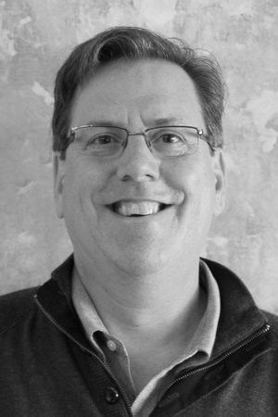
Scott Busby, AIA
TN Small Firm Exchange Representative
AIA Tennessee >> 2023 Annual Business Meeting

Slide 21

Approximately 75% of all firms within the AIA are small firms
(less than 10 employees),
which equates to
14,459 small firms within the organization.
~26.8% = sole practitioners = 5,173
~33.5% = 1-5 employees = 6,459
~14.7% = 5-10 employees = 2,827
We need to find ways to leverage that size for
collaboration and influence,
just like the individual large firms do.
An AIA National Member Group
(Since 2005)
www.aia.org/sfx

Slide 22

The mission of the AIA Small Firm Exchange (SFx) is to advance the mutual interests of architects practicing in small firms. The objectives of the AIA SFx are three-fold:
Advocate the value of small firms, the national SFx, and local SFx groups, both within the AIA and to the public.
Curate and disseminate the most pertinent resources and information, from the AIA & elsewhere, that benefit small firms.
Inform the AIA of current issues facing small firms and areas in which current resources/ information are lacking.
The Mission of SFx
www.aia.org/sfx

Slide 23
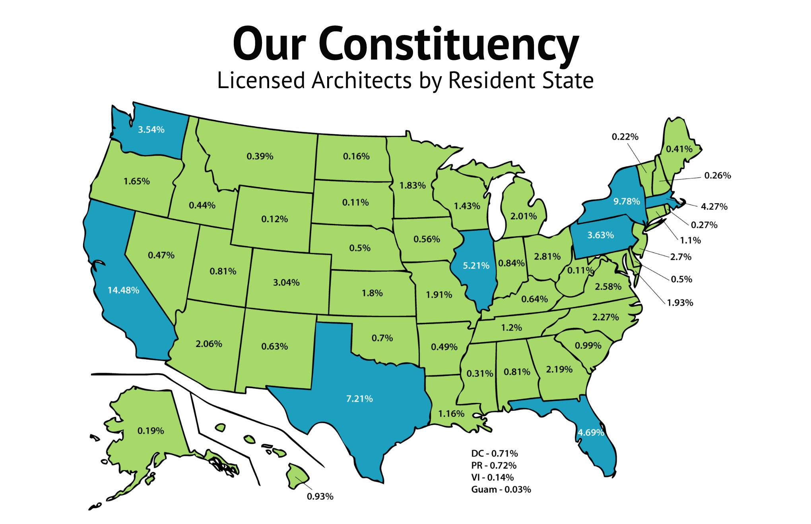

Slide 24
2023 SFx Goals

Slide 25
The National SFx primary goals this year in our mission to inform are:
Connect with all states to better understand the needs of small firms within each state.
Support local SFx Groups with Resources such as Best Practices
Hold internal Roundtable Discussions of topics important to Board Members and the work of small firms.
Inform
www.aia.org/sfx

Slide 26
Local TN Chapter Representatives:
AIA Chattanooga: Jared Hueter, AIA
AIA East TN: Josh Wright, AIA
AIA Memphis: Joyce S. Love, AIA
AIA Middle TN: Chad Polk, AIA
Northeast TN: Michael Stone, AIA
2023/2024 Tennessee goals:
Establish local groups with quarterly meetings.
Build network of small firms.
Sfx programs at AIA TN Conference
Add small firm category to design awards
Gather
Brainstorm
Promote
Disseminate
www.aia.org/sfx

Slide 27
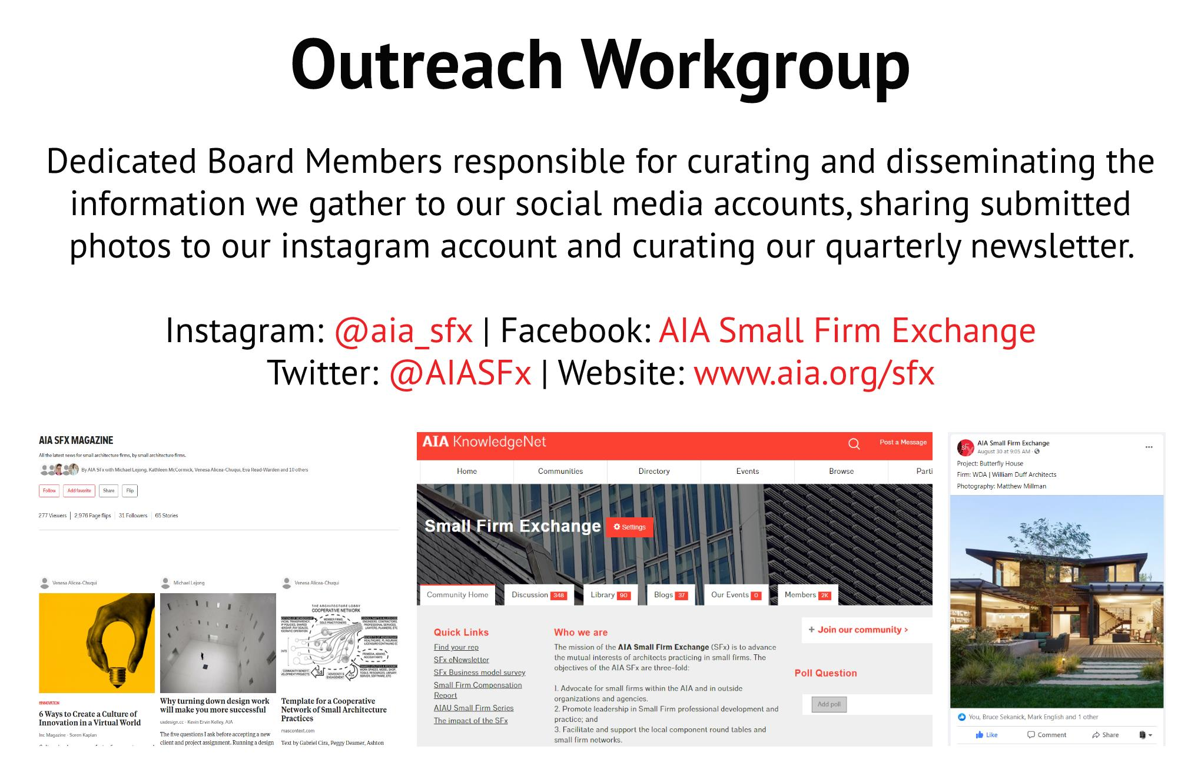

Slide 28
Thank You!

Slide 29
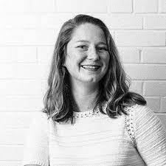
Sarah Page, AIA
Young Architect Representative
AIA Tennessee >> 2023 Annual Business Meeting

Slide 30

What is the YAF?
2023

Slide 31
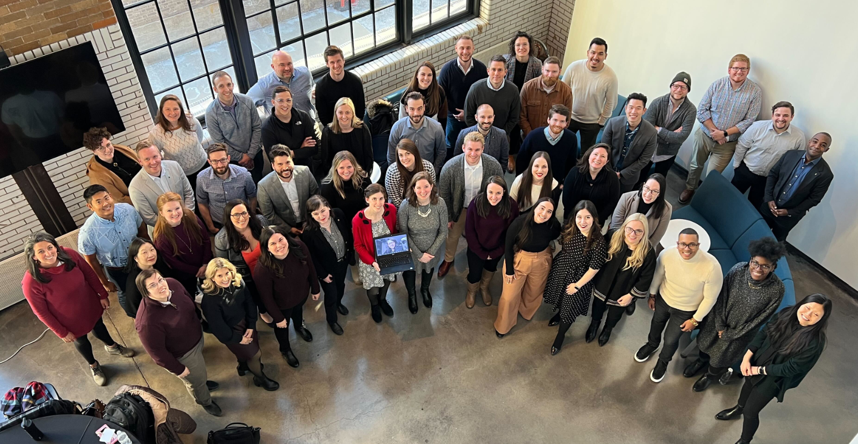
2023 Annual Meeting in St. Louis, MO

Slide 32

History of YAF
The Young Architects Forum (YAF) is an outgrowth of a 1989 AIA Grassroots program involving 36 young architects from around the nation. The issues raised and potential benefits visualized at that meeting led to the 1991 formation of a national YAF Committee.
In 2021, the YAF adopted the AIA Regions Task Force recommendation of the state based representation model.
Notes:
The YAF Committee, modeled on the structure of the College of Fellows (COF), encourages the development of national and regional programs of interest to young architects and the creation of YAF groups within local chapters.
YAF serves to help emerging designers network and as a collective voice for architects licensed 10 years or less.

Slide 33





YAF Mission | Vision
ENGAGE recently licensed Architects in leadership to become agents of change within the Institute and the profession overall
INSPIRE professional growth among recently licensed Architects through camaraderie within the Institute
ADVOCATE for issues of particular relevance to recently licensed Architects to the Institute
SERVE to make AIA memberships meaningful to recently licensed Architects through programs and services that effectively anticipate, meet and exceed their needs
PROMOTE mentorship at all career stages to enhance personal growth, community involvement, and professional development

Slide 34
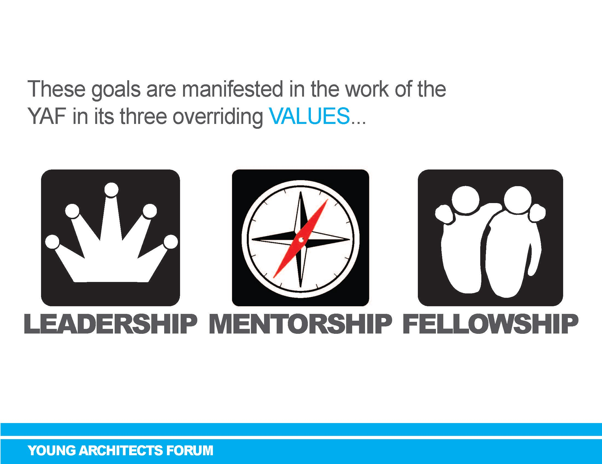
YAF Values
LEADERSHIP is the practice of actively engaging recently licensed Architects to affect positive change for the betterment of other members, their firms, their communities, and the Institute overall.
MENTORSHIP is the bi-directional partnership of sharing knowledge, skills, information, and perspective to enhance professional and personal growth.
COLLEGIALITY is the exploration of connections, sharing similar interests, ideals, or experiences on equal terms.

Slide 35
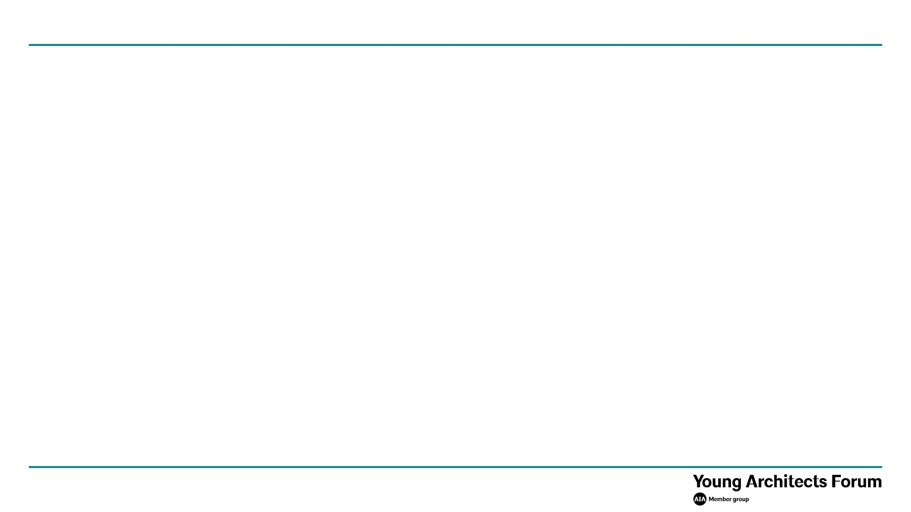

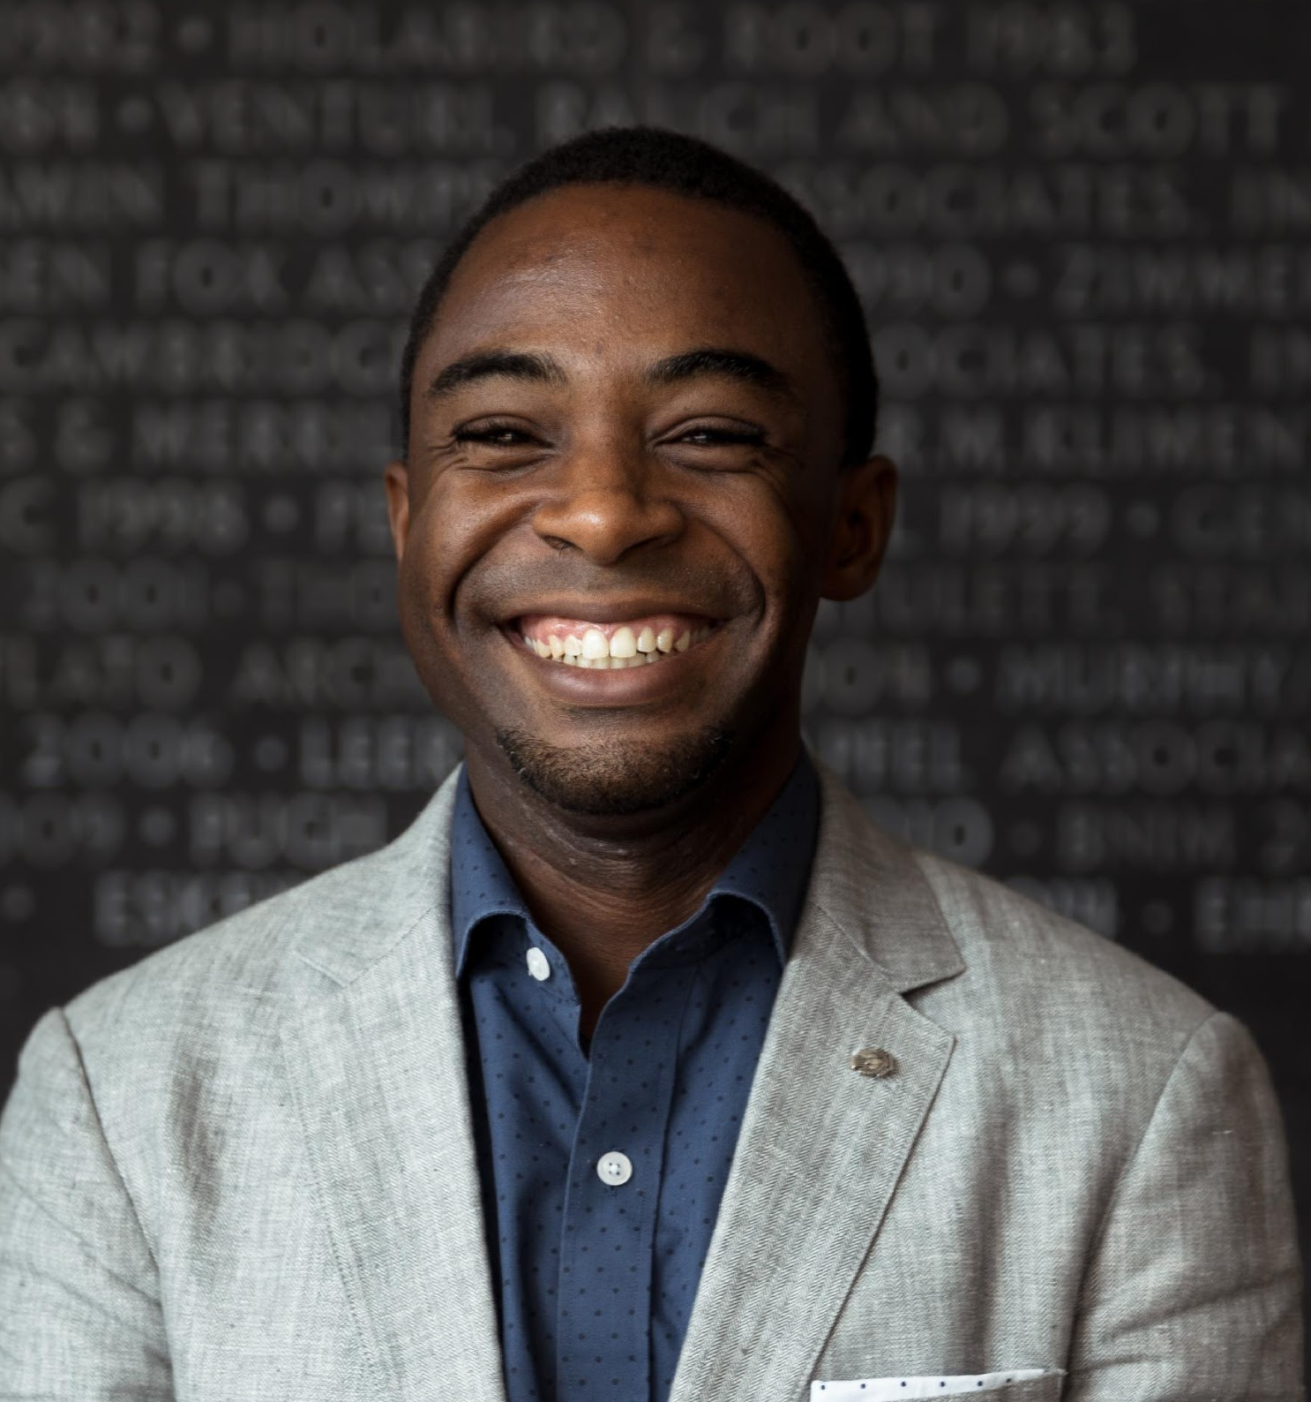
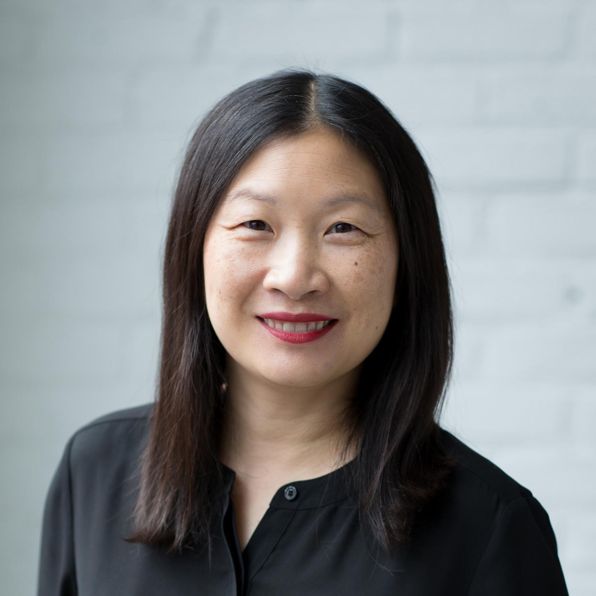
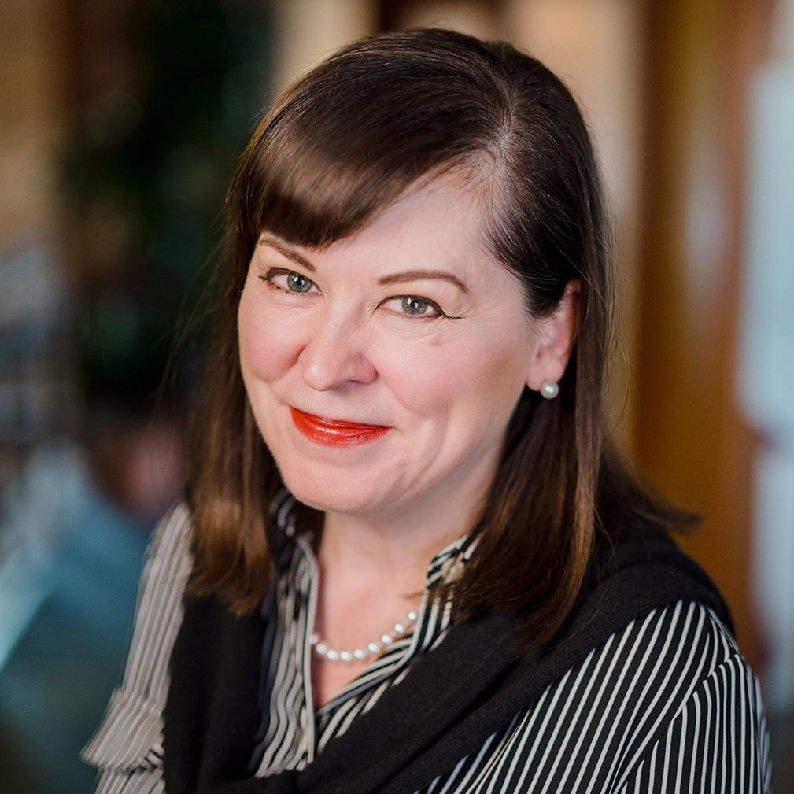
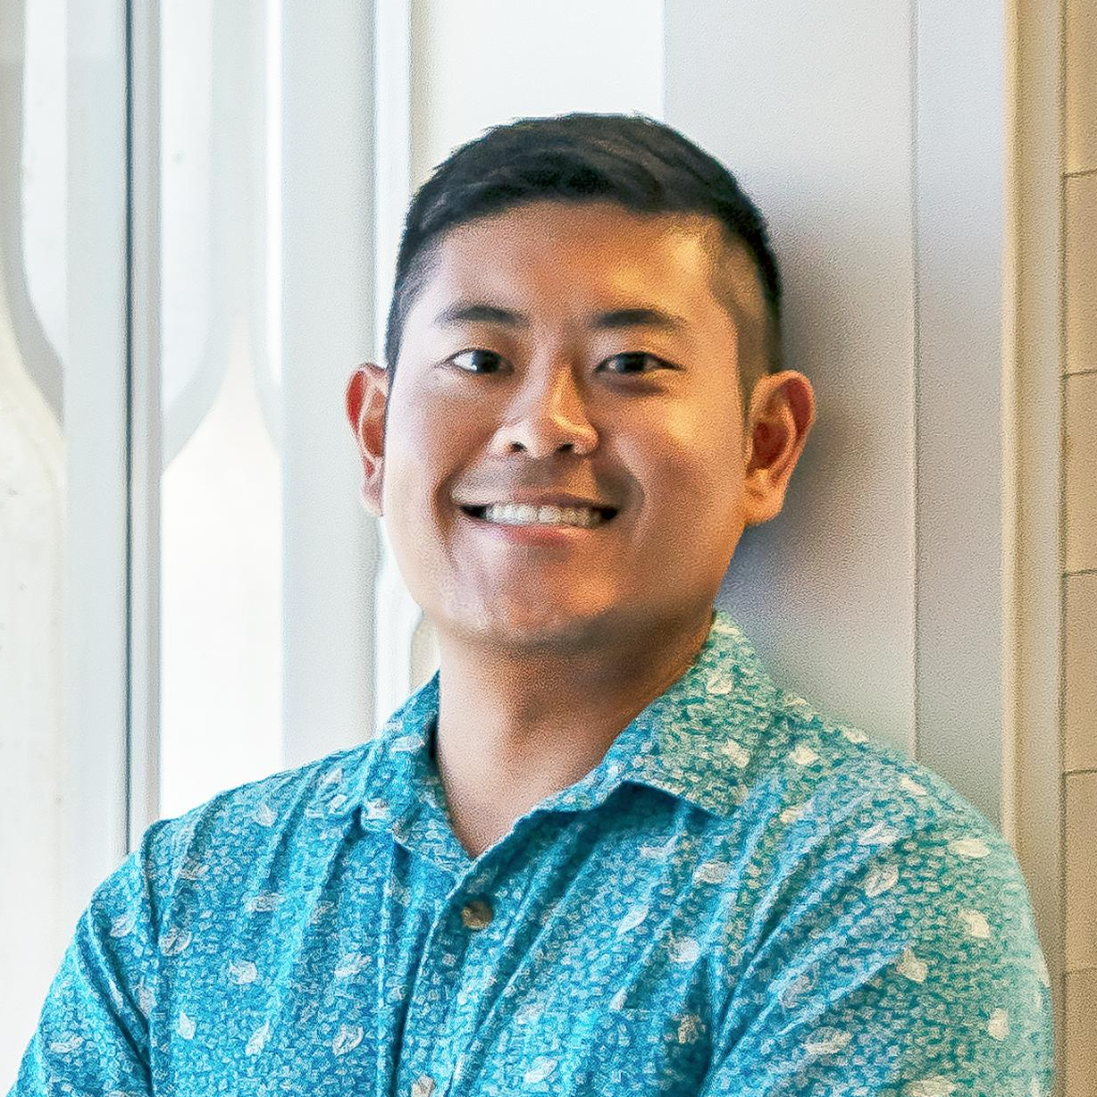
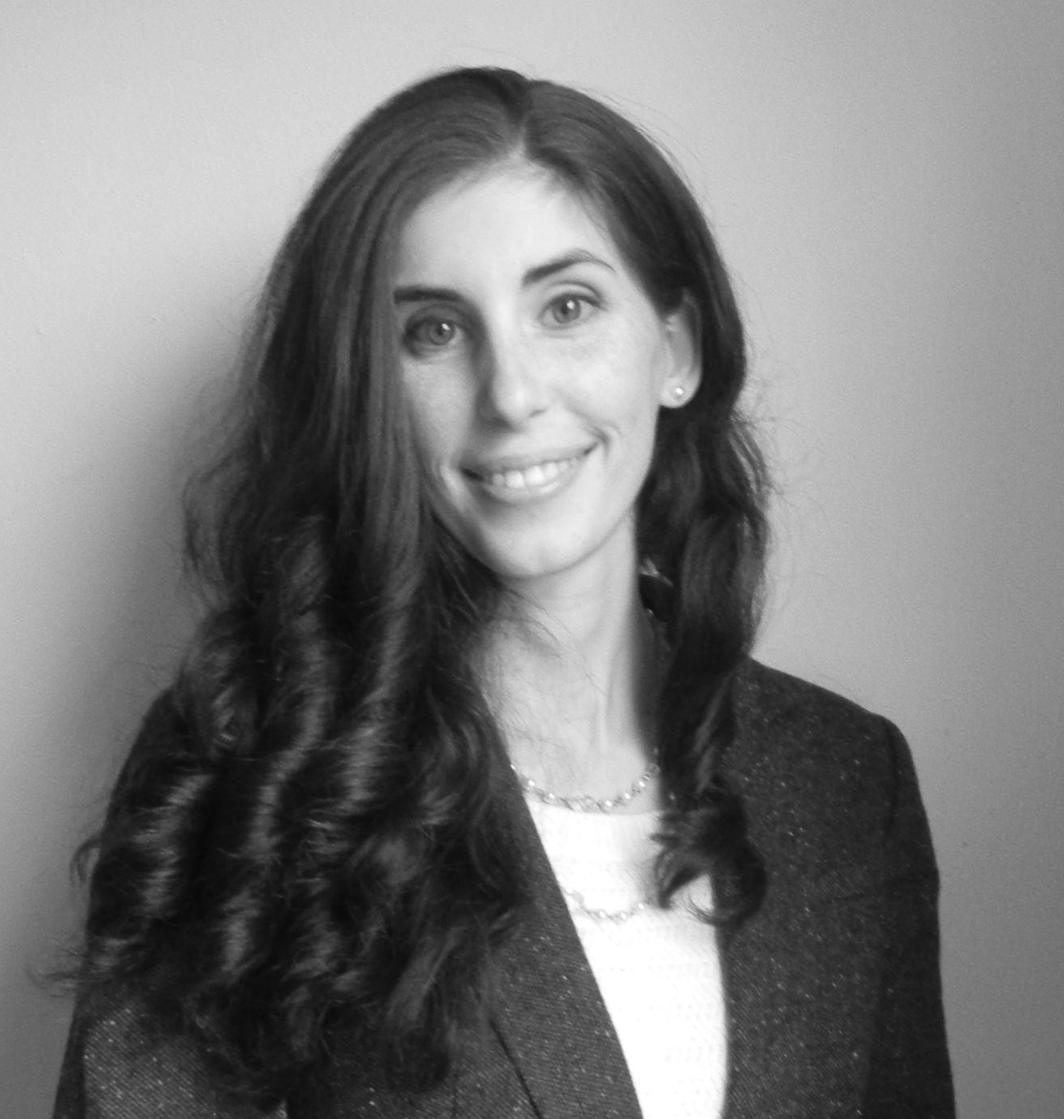
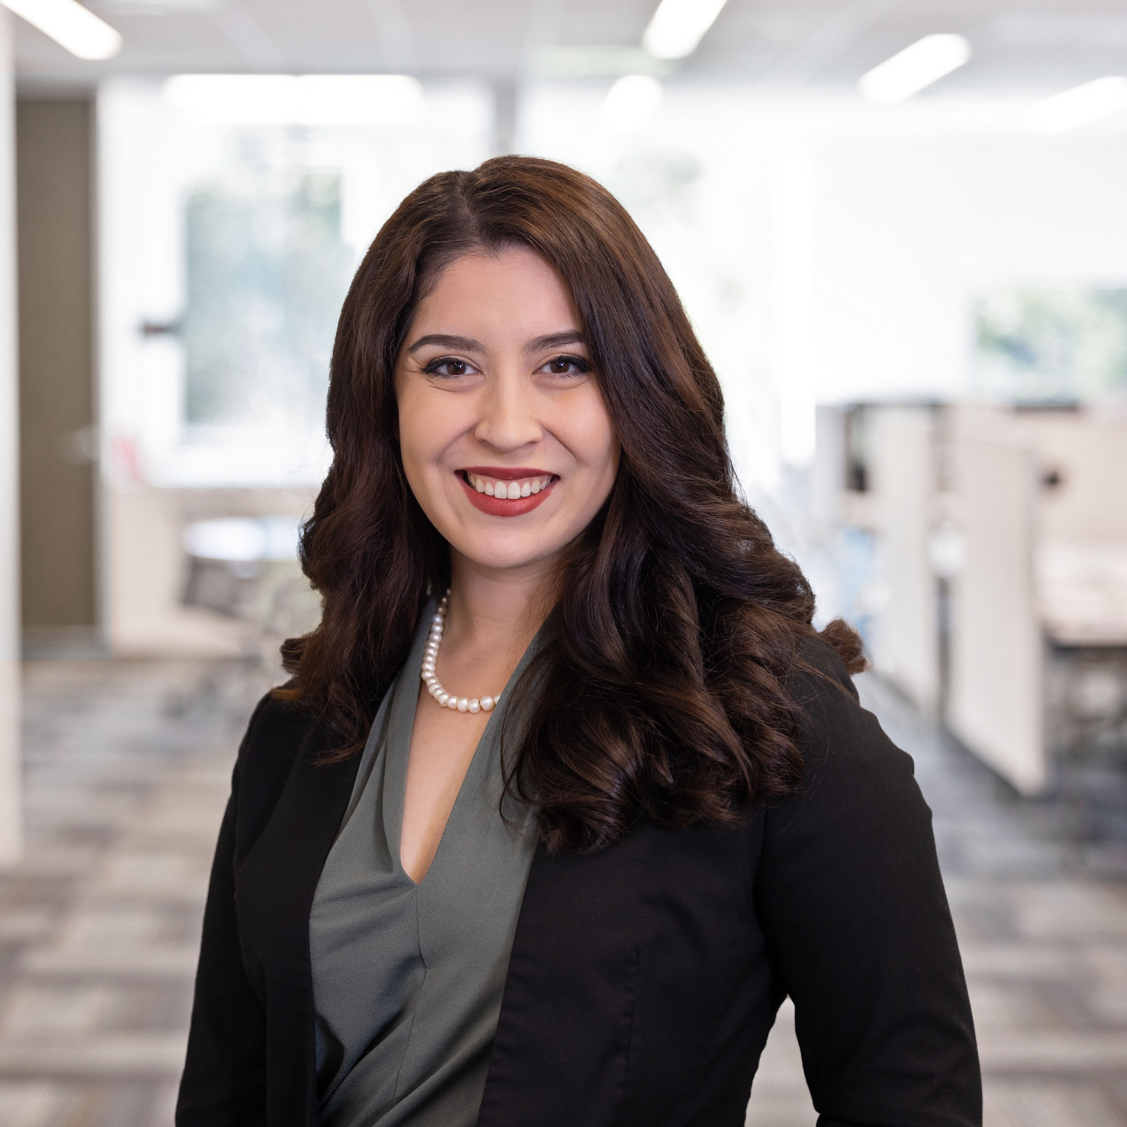
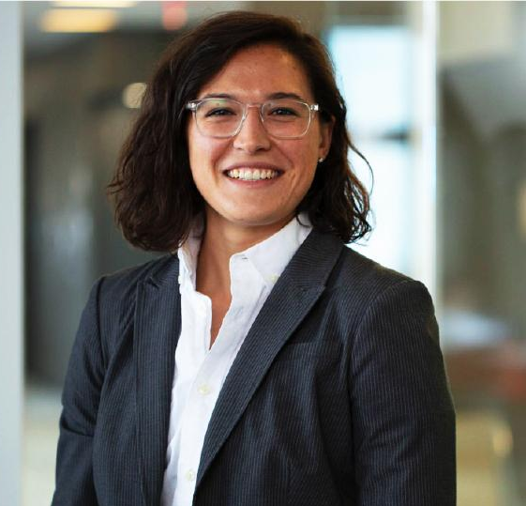
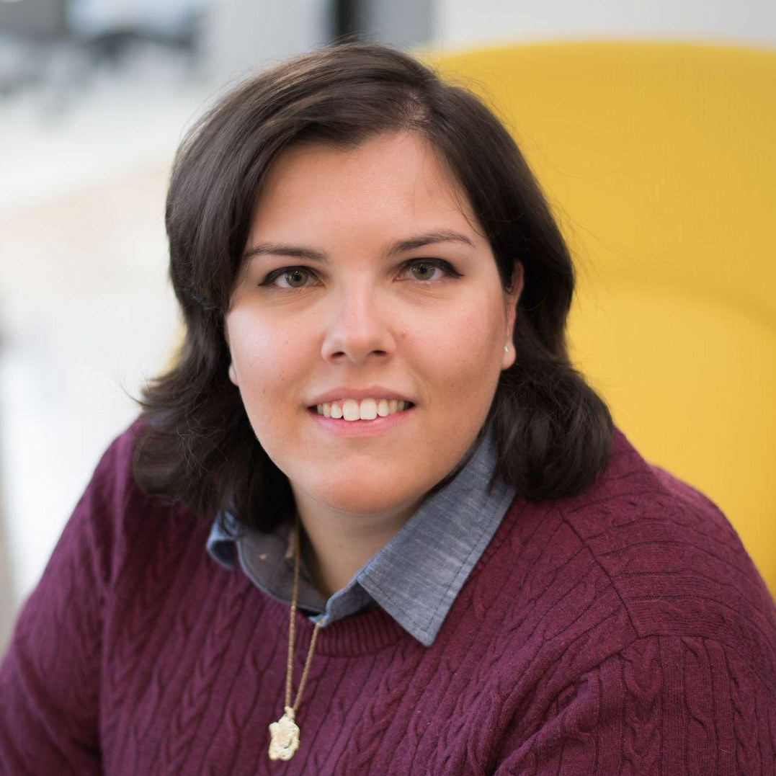
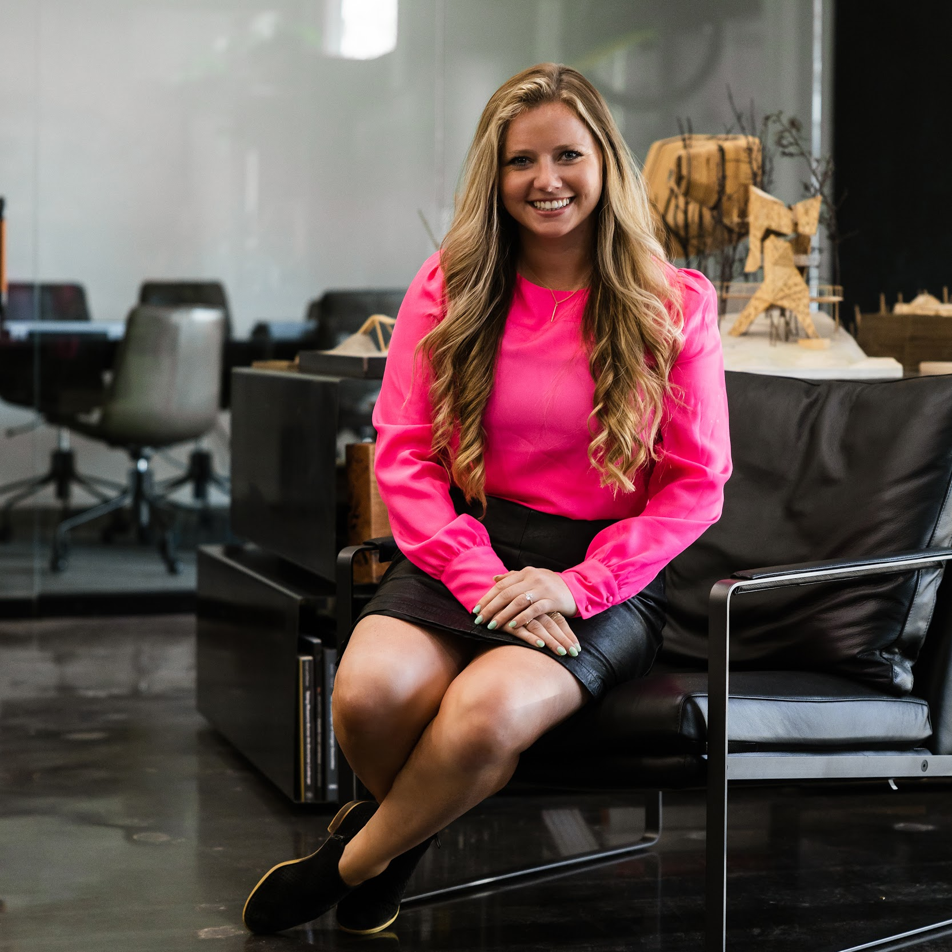
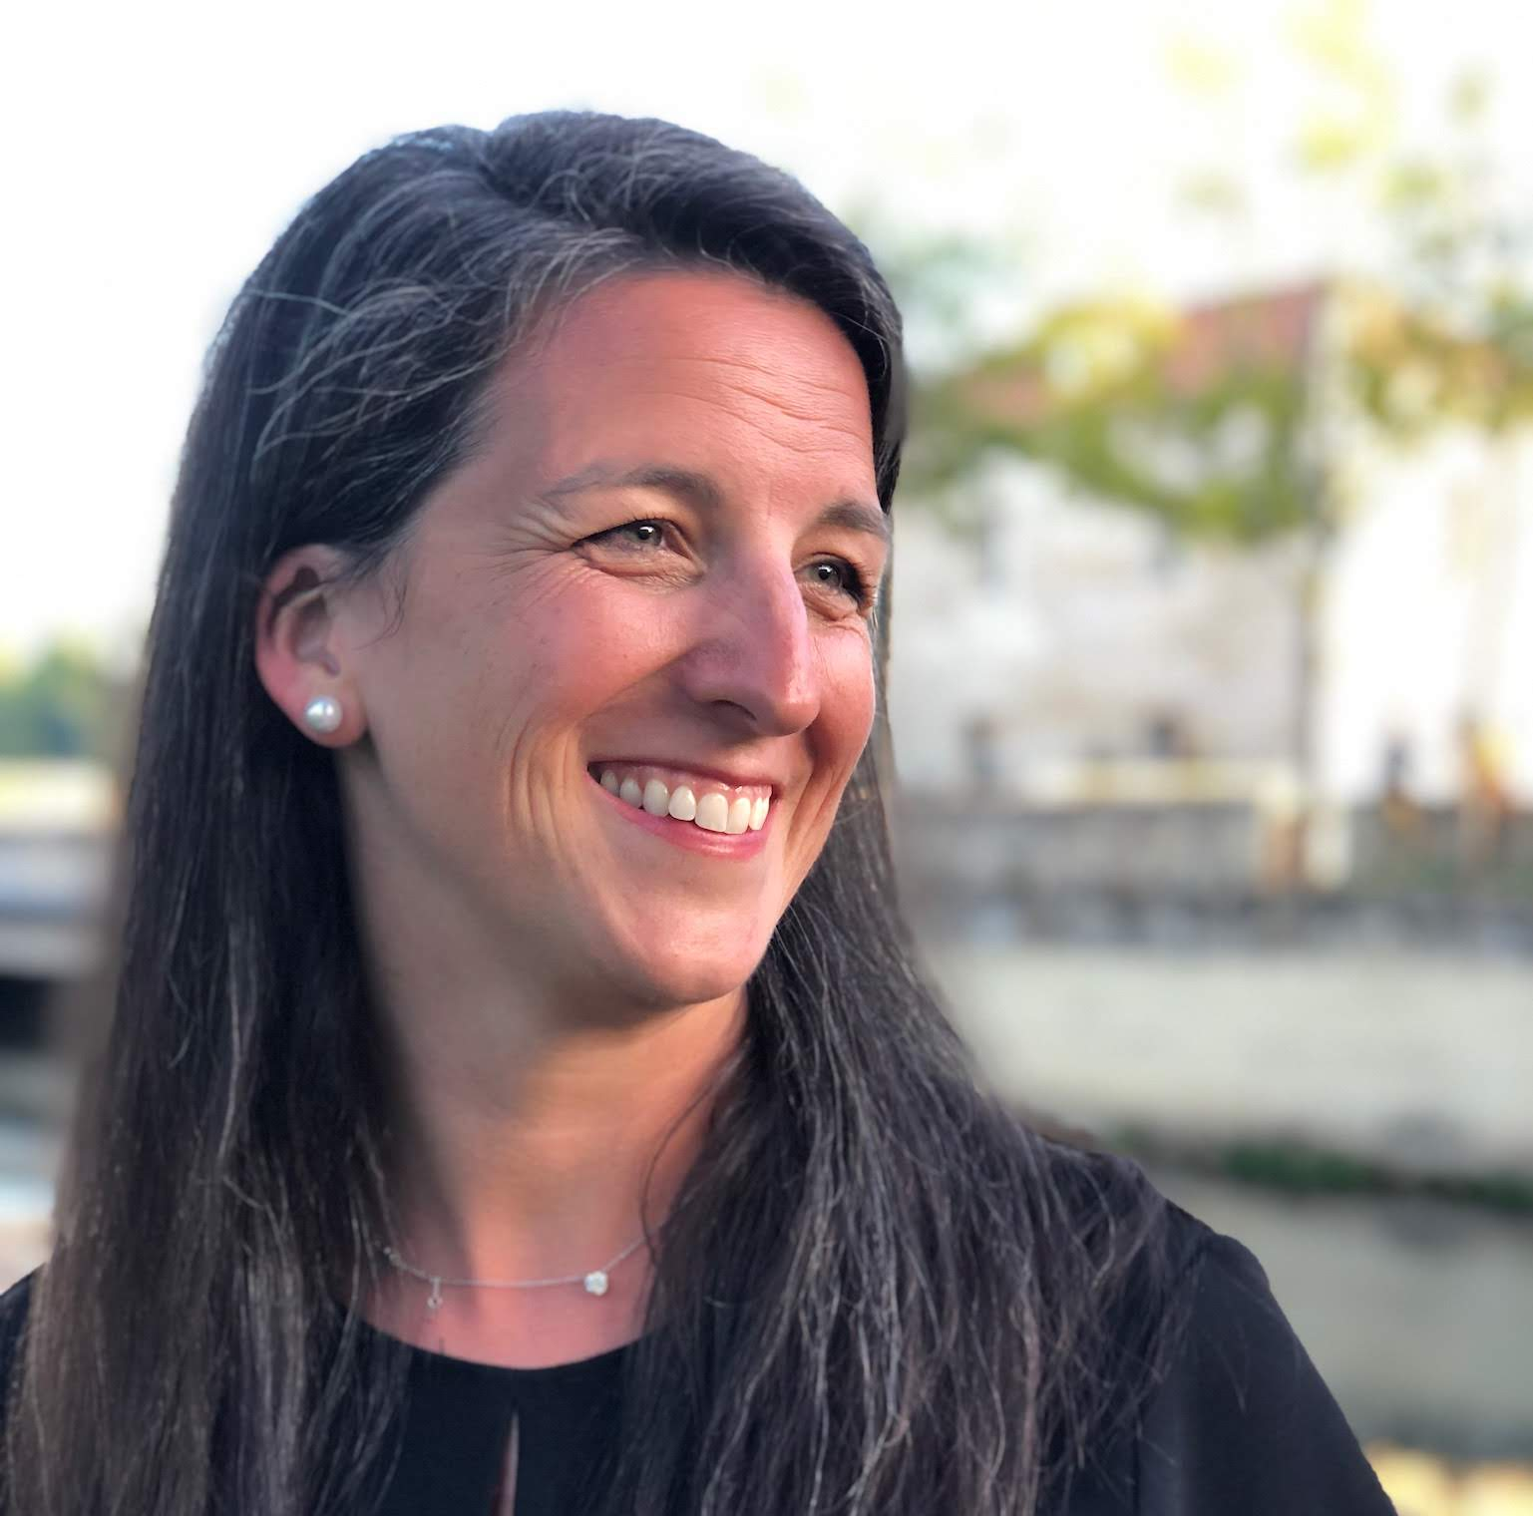



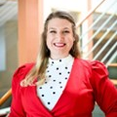




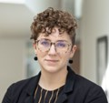








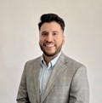

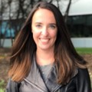






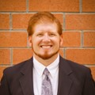
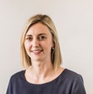

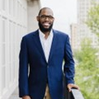


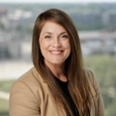




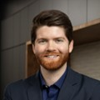






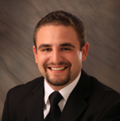
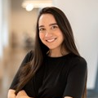
YAF Structure
National Advisory Committee (AdCom)
AIA STAFF
LIAISON
STRATEGIC COUNCIL LIAISON
COLLEGE OF FELLOWS
LIASION
CHAIR
VICE CHAIR
PAST CHAIR
EACH DIRECTOR AND THE PAST CHAIR LEAD A FOCUS GROUP OF YOUNG ARCHITECT REPRESENTATIVES.
COMMUNICATIONS
DIRECTOR
COMMUNITY DIRECTOR
ADVOCACY
DIRECTOR
KNOWLEDGE DIRECTOR
STRATEGIC VISION DIRECTOR
AK
ND
ME
MT
PR
VT
53 YOUNG ARCHITECT REPRESENTATIVES

Slide 36
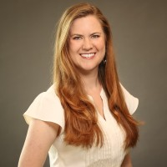
RACHEL GRESHAM
YAF Structure
National Advisory Committee (AdCom)
AIA STAFF
LIAISON
STRATEGIC COUNCIL LIAISON
COLLEGE OF FELLOWS
LIASION
CHAIR
VICE CHAIR
PAST CHAIR
EACH DIRECTOR AND THE PAST CHAIR LEAD A FOCUS GROUP OF YOUNG ARCHITECT REPRESENTATIVES.
COMMUNICATIONS
DIRECTOR
COMMUNITY DIRECTOR
ADVOCACY
DIRECTOR
KNOWLEDGE DIRECTOR
STRATEGIC VISION DIRECTOR
AK
ND
ME
MT
PR
VT
53 YOUNG ARCHITECT REPRESENTATIVES

Slide 37
Role of the Young Architect Representative
Advocate for issues of importance to recently licensed architects at the local, state and national level
Be the bi-directional conduit of information from National to State; State to Local and vice versa
Share quarterly YAF Connection publications & opportunities to become contributors
Provide update reports to the State AIA Board of YAF engagement
  Attend National YAF Committee calls (every other month)
  Coordinate with State Associate Rep (STAR), Strategic Council Rep, and College of Fellows Rep – T.A.L.N.
  Participate in one YAF focus group – Special Projects

Slide 38

Role of the Young Architect Representative
Advocate for issues of importance to recently licensed architects at the local, state and national level
Be the bi-directional conduit of information from National to State; State to Local and vice versa
Share quarterly YAF Connection publications & opportunities to become contributors
Provide update reports to the State AIA Board of YAF engagement
  Attend National YAF Committee calls (every other month)
  Coordinate with State Associate Rep (STAR), Strategic Council Rep, and College of Fellows Rep – T.A.L.N.
  Participate in one YAF focus group – Special Projects

Slide 39
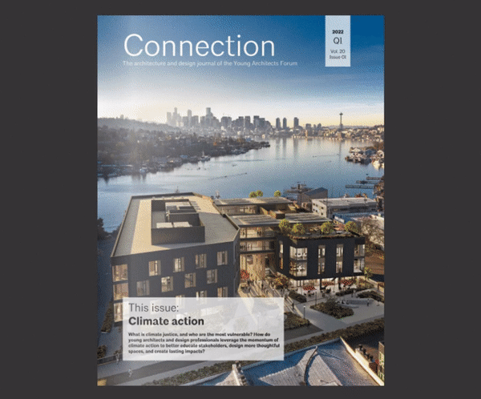


Stay Connected
YAF 2023 1-pager goals & priorities
Connection our quarterly e-publication
Now Ya Know our bi-monthly snapshot
Engage on KnowledgeNet
Follow us on social media
@AIAYAF
aiayaf
@AIAYAFNational
AIA YAF

Slide 40
Questions ?

Slide 41
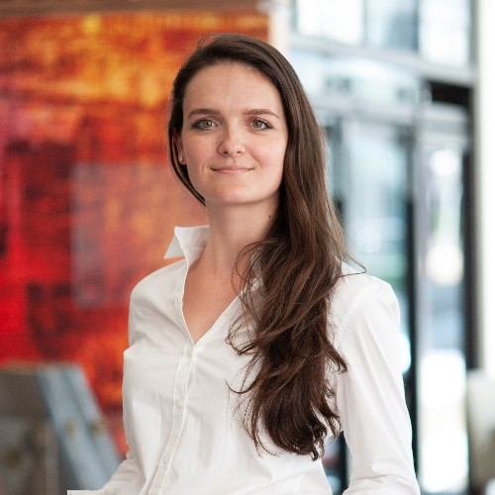
Katie Hunt, AIA
TN State Associate Representative
AIA Tennessee >> 2023 Annual Business Meeting

Slide 42
President's Remarks
AIA Tennessee >> 2023 Annual Business Meeting

Slide 43
Recipients of the McKissack & McKissack Endowment Fund
Nicholas Strong
Carmen Fluellen
Colby Mitchell
Hector Carrera Miranda
Isaac Barrantes
Contributions go toward scholarships to assist minority EPs in Tennessee pay for expenses incurred for licensure. Applicants must be pursuing architecture licensure in the state of Tennessee.
Creation of this program is an outcome of the Collective Declaration to Acknowledge, Listen, Learn, Act. AIA TN’s Justice, Equity, Diversity, Inclusion (JE+DI) committee created this program as one step to decrease the barrier to entry for young, minority members.
AIA Tennessee >> 2023 Annual Business Meeting >> Thank You!

Slide 44

Presidential Award of Excellence for Distinguished Service
Who has contributed time and energy over and above that which is normally expected to enhance and improve the Profession
of Architecture – whose efforts and achievements have significantly improved the position and presence of the Society (AIA TN) – whose initiative to lead and voluntary commitment to serve have been an example and asset for not only the Society but the entire profession.
TROPHY BY FORMGREY STUDIO
AIA Tennessee >> 2023 Annual Business Meeting >> Thank You!

Slide 45
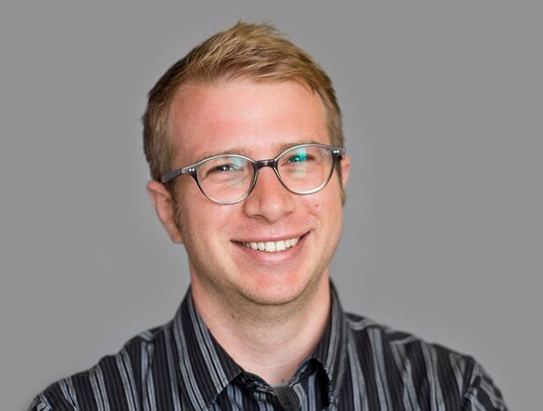
Presidential Award of Excellence for Distinguished Service
Will Randolph, AIA
AIA Tennessee >> 2023 Annual Business Meeting >> Thank You!

Slide 46
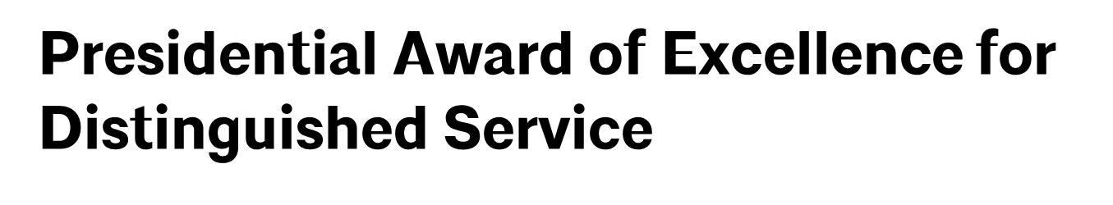
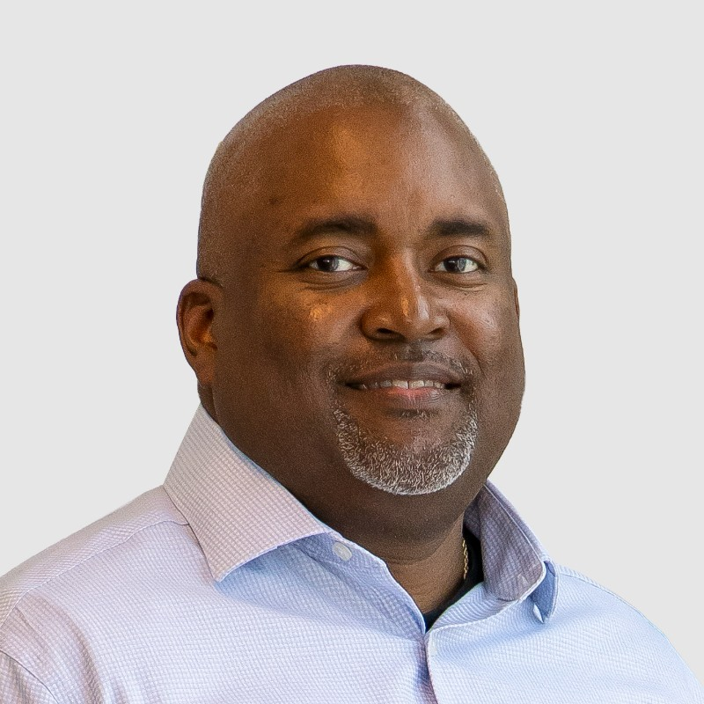
Julius Mitchell, AIA
AIA Tennessee >> 2023 Annual Business Meeting >> Thank You!

Slide 47
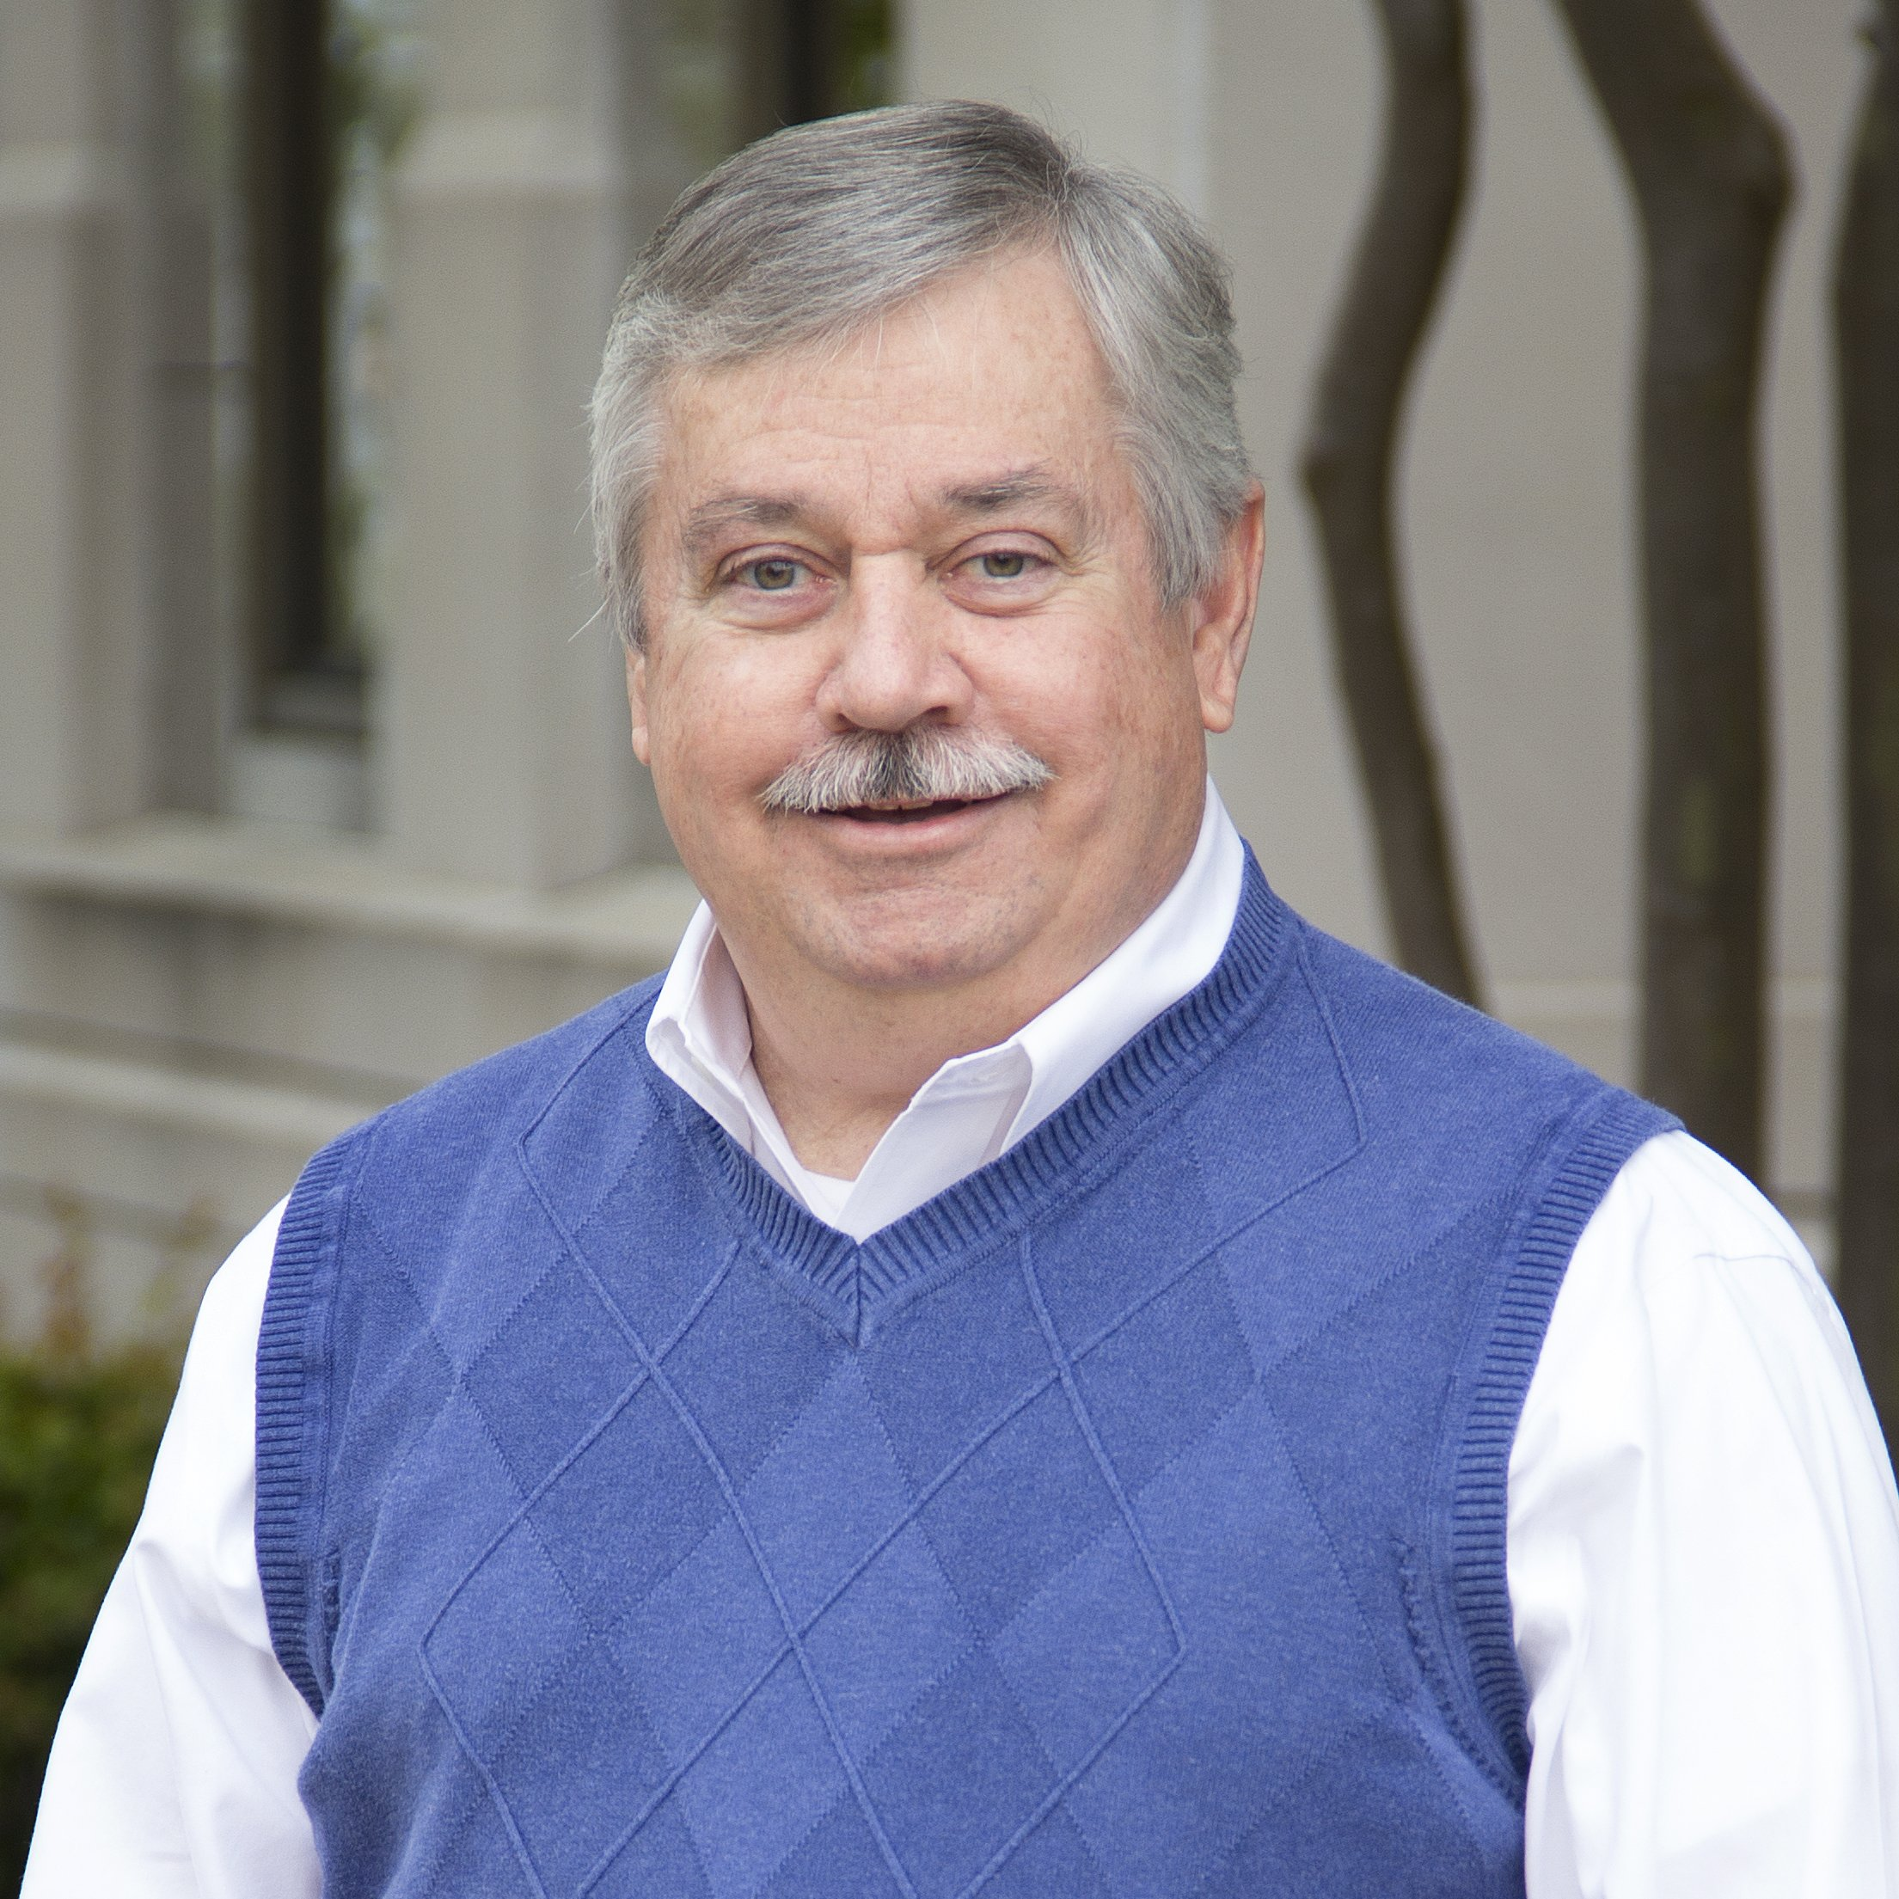
Frank Wagster, AIA
AIA Tennessee >> 2023 Annual Business Meeting >> Thank You!

Slide 48
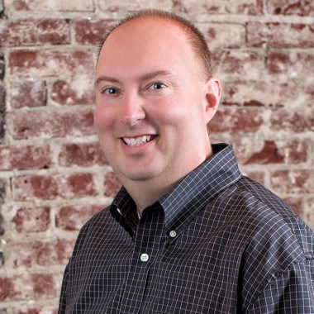
Presidential Award of Excellence for Distinguished Service
Greg Campbell, AIA
AIA Tennessee >> 2023 Annual Business Meeting >> Thank You!

Slide 49
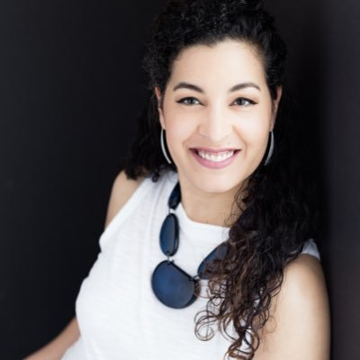
Presidential Award of Excellence for Distinguished Service
Joyce Selina Love, AIA
AIA Tennessee >> 2023 Annual Business Meeting >> Thank You!

Slide 50
Adjournment
AIA Tennessee >> 2023 Annual Business Meeting

Slide 51
Lighting WELL
Lighting & the WELL Building Standard
Presented by Brian Onody
SESCO Lighting
AIA Tennessee >> 2023 Annual Business Meeting

